Slide 1
Distributed Cloud Storage
Tomas Baltrunas & Bartosz Śwituszak

Slide 2




Project Aims
Distributed Cloud for Storage
Storage of files on servers (nodes)
Nodes connected via the Internet
Distributed network model (node is client and server)
Effective Cloud
Integrity and reliability
Speed
Security & authentication
GUI clients to access the model
Desktop
Web
Mobile

Slide 3
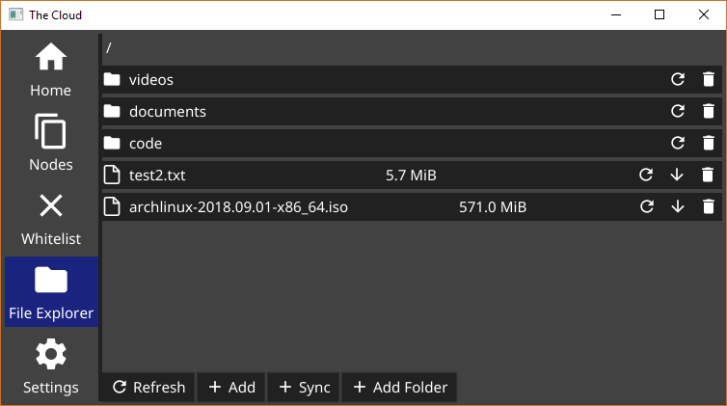
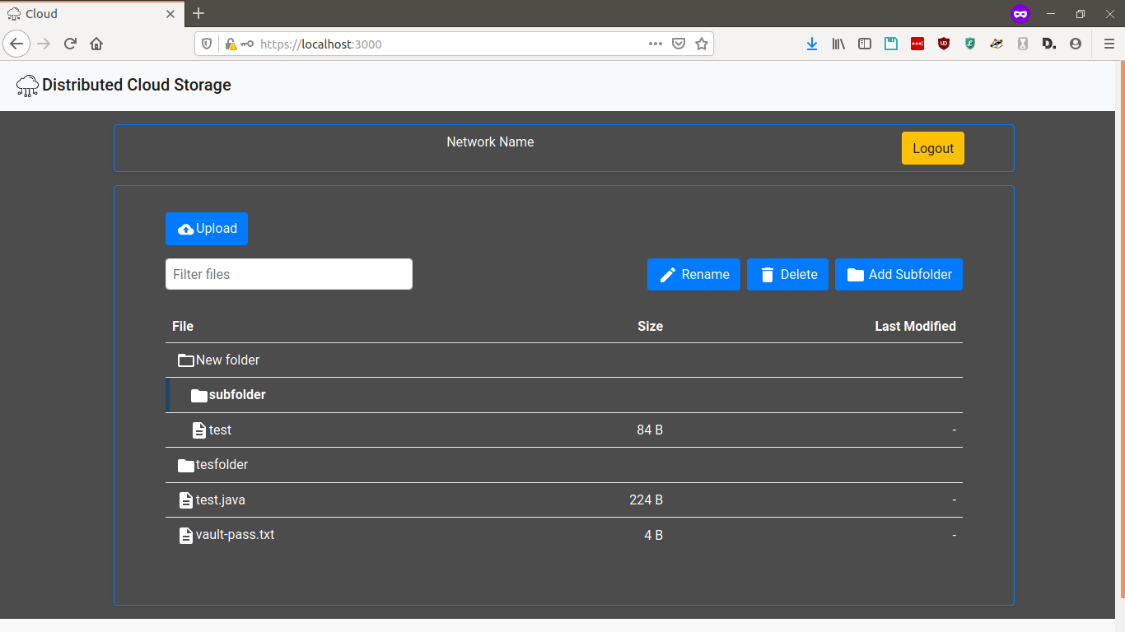
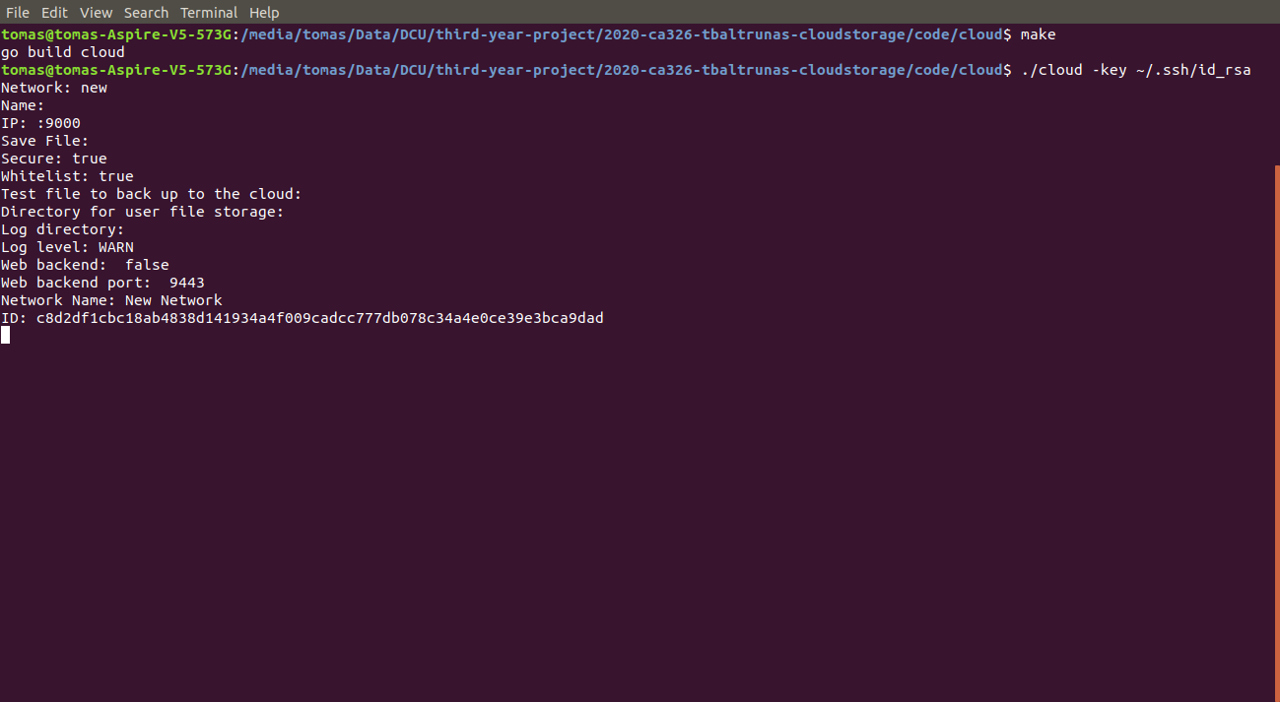
Achievements
CLI + GUI (desktop & web) clients
Secure, efficient, reliable distributed cloud
Notes:
Distributed Cloud
Secure communications via encrypted keys
Storage
Split files into chunks
Redundancy (replication and anti-affinity)
Optimized based on storage load and network factors (latency)
CLI for setting up a node
Desktop GUI client
Set up a node
Manage files and directories
Authentication via whitelist
Website
Access and upload files, organise into directories
Login system
Mobile friendly
Demo desktop GUI.
Demo website.
Demo CLI.
[Prepare walkthrough video in case of failure to demo live]
Demo distribution GIF.
Secure:
Cloud - whitelist based on ID
Communications encrypted with keys
Web authentication. Hashed and salted passwords.
Efficient
Distribution algorithm, optimised for load and network (latency)
File chunking
Reliable
Cloud locks
File redundancy (replication and anti-affinity)

Slide 4



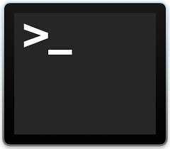





Learning Outcomes
Networking
Creating a distributed system
Designing own TCP-based protocol
Storing files on OS
Encryption
Unit testing
File upload and download
Algorithms
Implementing redundancy (replication, anti-affinity)
Concurrency and synchronisation
Chunking files
Other
Ansible, Makefile
GitLab CI, Google Cloud Platform
Logging
Notes:
Golang
Networking
Creating a client and a server
Designing own TCP-based protocol
CLI
Storing files on OS
Encryption
Unit testing
Algorithms
Implementing redundancy (replication, anti-affinity)
Concurrency and synchronisation
Splitting files into chunks
Desktop GUI development
Fyne
Cross-platform GUI development
Web development
React.js front-end
Bootstrap CSS styling
Designing a RESTful API
Go backend server
HTTPS (TLS certs), JWS (token based authentication)
File download and upload on the web
PostgreSQL with account credential storage (encrypted)
Other
Ansible
Makefile
GitLab CI
Google Cloud Platform
Logging

Slide 5
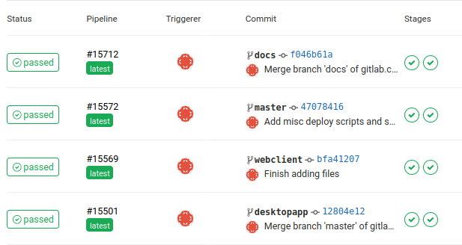
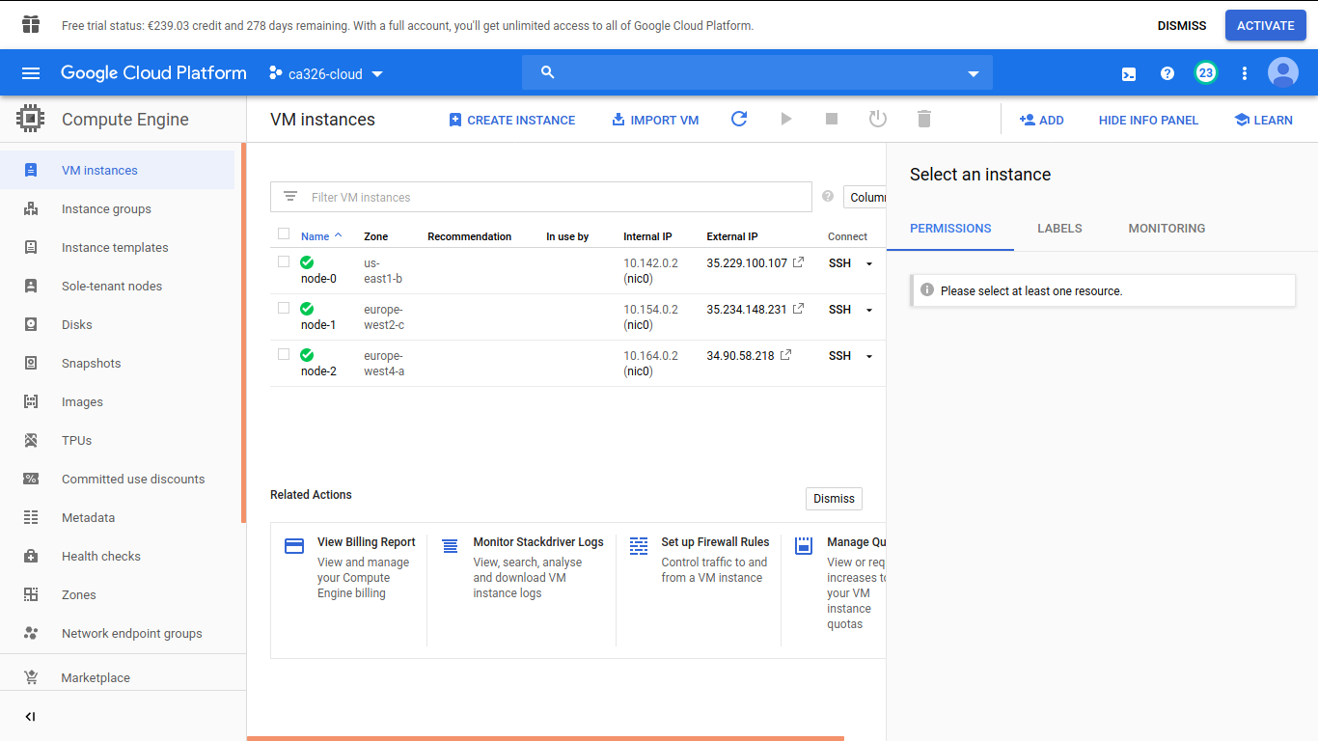

Testing
Unit/Integration Tests (GitLab CI)
System Testing
User Testing (verbal, website)
Notes:
Show GCP

Slide 6
Questions
Thank you for your feedback

